Slide 1
Object Oriented Programming
Inheritance

Slide 2
Class & Object
A class is to an Object what a blueprint is to a house
A class establishes the characteristics and the behaviors of the object
Classes are the plan; objects are the embodiment of that plan
Many houses can be built from the same blueprint

Slide 3
Inheritance
Inheritance allows a software developer to derive a new class from an existing one
The existing class is called the parent class, or super class, or base class
The derived class is called the child class or subclass
As the name implies, the child inherits characteristics of the parent

Slide 4
Inheritance
Software reusability
Create new class from existing class
Absorb existing class’s data and behaviors
Enhance with new capabilities
Subclass extends superclass
Subclass
More specialized group of objects
Behaviors inherited from superclass
Can customize
Additional behaviors

Slide 5
Hierarchy
Bird
call: ? color:? food:? movement:?
FlyingBird
call: ? color:? food:? movement:flew
WalkingBird
call: ? color:? food:? movement:walked
Parrot
call: Squawk color:? food: fruit
Owl
call:? color:? food:mice
Goose
call: honk color: gray food: bugs
Ostrich
call: neek-neek color: brown food: grass
TalkingParrot . . .

Slide 6
Inheritance hierarchy for university CommunityMembers.
CommunityMember
Employee
Student
Alumnus
Faculty
Staff
Administrator
Teacher

Slide 7
Inheritance hierarchy for Shapes.
Shape
TwoDimensionalShape
ThreeDimensionalShape
Circle
Square
Triangle
Sphere
Cube
Tetrahedron

Slide 8
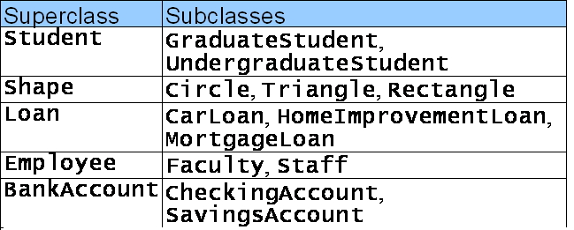
Superclasses and Subclasses (Cont.)

Slide 9
Class hierarchy
Direct superclass
Inherited explicitly (one level up hierarchy)
Indirect superclass
Inherited two or more levels up hierarchy
Single inheritance
Inherits from one superclass
Multiple inheritance
Inherits from multiple superclasses
Java does not support multiple inheritance

Slide 10
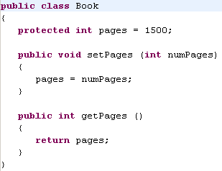

Slide 11
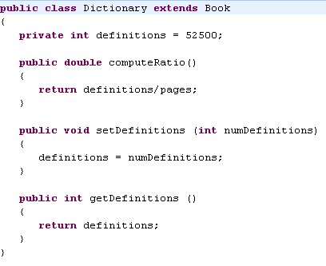

Slide 12
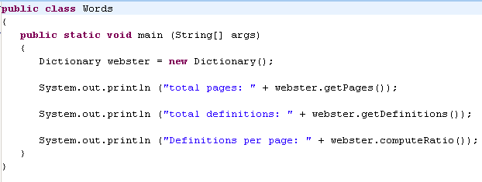

Slide 13
Class Diagram for Words
Book
# pages : int
+ pageMessage() : void
Words
Dictionary
- definitions : int
+ main (args : String[]) : void
+ definitionMessage() : void

Slide 14
Inheritance
A programmer can tailor a derived class as needed by adding new variables or methods, or by modifying the inherited ones
Software reuse is a fundamental benefit of inheritance
By using existing software components to create new ones, we capitalize on all the effort that went into the design, implementation, and testing of the existing software

Slide 15
The protected Modifier
Visibility modifiers affect the way that class members can be used in a child class
Variables and methods declared with private visibility cannot be referenced by name in a child class
They can be referenced in the child class if they are declared with public visibility -- but public variables violate the principle of encapsulation
There is a third visibility modifier that helps in inheritance situations: protected

Slide 16
The protected Modifier
All methods & variables (even those declared private) are inherited by the child class
Their definitions exist and memory is reserved for the variables
However they CANNOT be referenced by name

Slide 17
The super Reference
Constructors are not inherited, even though they have public visibility
Yet we often want to use the parent's constructor to set up the "parent's part" of the object
The super reference can be used to refer to the parent class, and often is used to invoke the parent's constructor

Slide 18
The super Reference
A child’s constructor is responsible for calling the parent’s constructor
If the child constructor invokes the parent (constructor) by using the super reference, it MUST be the first line of code of the constructor
The super reference can also be used to reference other variables and methods defined in the parent class

Slide 19
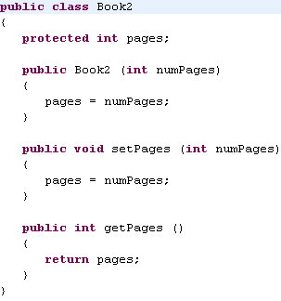

Slide 20
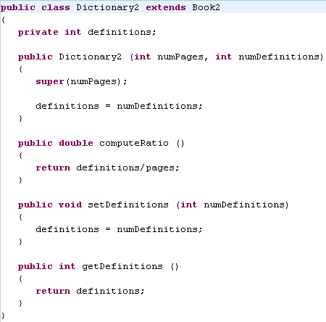

Slide 21
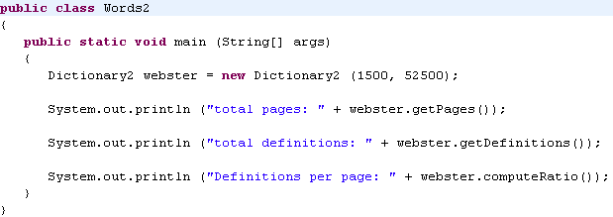

Slide 22
Overloading vs. Overriding
Overloading deals with multiple methods with the same name in the same class, but with different signatures
Overriding deals with two methods, one in a parent class and one in a child class, that have the same signature
Overloading lets you define a similar operation in different ways for different parameters
Overriding lets you define a similar operation in different ways for different object types

Slide 23
Multiple Inheritance
Java supports single inheritance, meaning that a derived class can have only one parent class
Multiple inheritance allows a class to be derived from two or more classes, inheriting the members of all parents
Collisions, such as the same variable name in two parents, have to be resolved
Java does not support multiple inheritance
Therefore following is illegal:
public class extends Animal, Mammal{}
In most cases, the use of interfaces gives us aspects of multiple inheritance without the overhead

Slide 24
The Object Class
A class called Object is defined in the java.lang package of the Java standard class library
All classes are derived from the Object class
If a class is not explicitly defined to be the child of an existing class, it is assumed to be the child of the Object class
Therefore, the Object class is the ultimate root of all class hierarchies

